Slide 1
Day 10 – 11 - 12 – JavaScript Fundamental

Slide 2
Recap
Array
Object
Destructuring
Spread and Rest Operation

Slide 3
DOM
Document Object Model
Structured representation of html documents
Allow JS to access html elements and styles to manipulate them

Slide 4
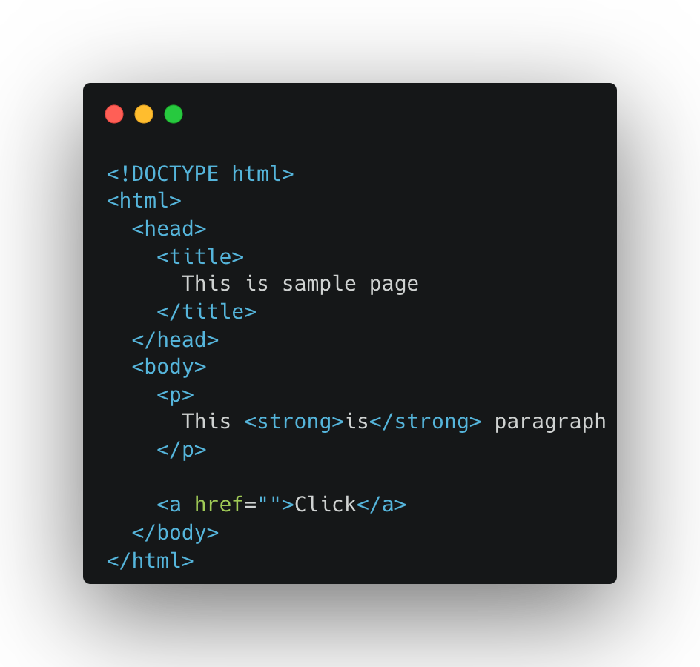
Dom Tree Structure
document
html
head
body
title
p
a
This is sample page
This …
strong
click
is

Slide 5
Dom
Document.querySelector()
Document.querySelectorAll()
Document.getElementById()
Document.getElementByClassName()
Document.getElementByTagName()

Slide 6
Update Data
Element.innerHTML
Element.textContent

Slide 7
Update Attribute
Element.classList.add
Element.classList.remove
Element.src
Element.value
Element.classList.toggle

Slide 8
Working with node

Slide 9
Eventhandler
Button
Keyboard

Slide 10
Event Propagation
Event.preventDefault()

Slide 11
Exercise
Guess a Number
Modal
Pig Game
To Do List
Expense Tracker

Slide 12
Feedback
What went well?
What went wrong?
What did you learn?

Slide 13
Credit
https://carbon.now.sh/
https://ascii.co.uk/art
https://appbrewery.com/

Slide 14
I believe that you learn the most if you don’t learn alone but find learning partners and other people with similar interest. - Unknown

